Slide 1
Regression analysis
Dr. Hemang Subramanian
Associate Professor & Director
Information Systems and Business Analytics

Slide 2



Objective of the Module
Definition of regression analysis
Types of regression models
Visualizing relationships
Linear equations – the basis of regression
The regression model and multiple regression techniques
Testing hypotheses
Key statistical metrics
Significance of P-values

Slide 3

Objective
Describe how predictors (explanatory variables) relate to the outcome variable.
Common applications of regression in data analysis.
Understanding hypotheses: Null and Alternative hypotheses.
Indicators of "goodness-of-fit": p-values, t-statistics, F-statistics, and R-squared values.

Slide 4
What is regression analysis?
Regression analysis is a technique employed to evaluate the relationship between two variables measured on an interval or ratio scale.
This method is essential for research within the fields of empirical social and political sciences.
Serving as a statistical alternative to controlled experiments, regression analysis allows researchers to infer causal relationships.

Slide 5
Regression models
Researchers convert verbal theories, hypotheses, and insights into structured models.
A model illustrates the connections between two or more variables and the circumstances under which they interact.
A regression model that consists of one dependent variable and one independent variable is termed a bivariate regression model.
A regression model that incorporates a dependent variable alongside two or more independent variables and/or control variables is identified as a multivariate regression model.
This model may also be known as multi-variable regression or multiple regressions.

Slide 6
Graphically deducing relationships
A scatterplot visualizes sample data points by positioning them within the X,Y coordinate system.
Typically, the X axis displays the values of the independent variable, while the Y axis shows the values of the dependent variable.
The X axis runs horizontally, whereas the Y axis is arranged vertically.

Slide 7
Scatterplots
Scatterplots allow you to study the flow of the dots, or the relationship between the two variables
Scatterplots allow political scientists to identify -- positive or negative relationships -- monotonic or linear relationships

Slide 8

Scatterplot Example

Slide 9
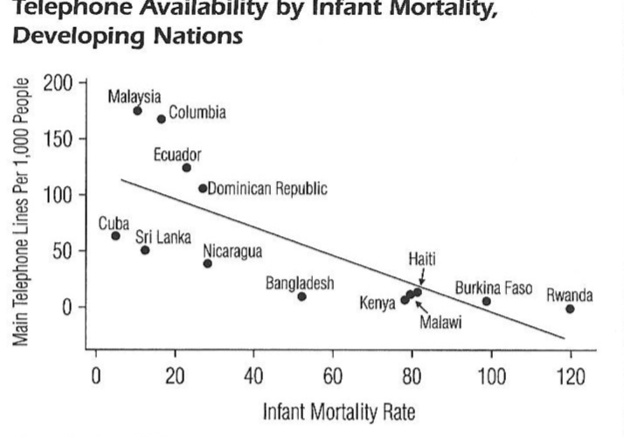
Scatterplot example 2

Slide 10
Linear Equation
A linear equation is represented as follows:
Y = bX + a
In this formula, Y symbolizes the dependent variable, X signifies the independent variable, and a represents the constant (the value of Y when X is zero).
The term b refers to the slope of the regression line.
(What information does the slope provide?)
The value a is known as the Y-intercept.

Slide 11
Regression Equation
The value of a can be either positive or negative. In high school algebra, a is often referred to as the intercept, as it represents the point where the slope line intersects the Y axis.
The coefficient b (the slope) can also be positive or negative. A positive slope indicates a positive correlation, while a negative slope indicates a negative correlation.
The meaningful interpretation of the slope coefficient is influenced by the specific variables at play, their coding, and the scale used for these variables. While larger coefficients might suggest a stronger relationship, this is not always the case.

Slide 12
The Regression model
Regression analysis aims to identify an equation that provides the closest match to the data.
In this process, an equation is determined so that its graphical representation forms a line that reduces the squared differences in vertical distance between the data points and the line itself.

Slide 13
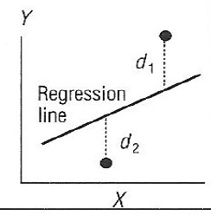
Regression model
d1 and d2 denote the distances of the observed data points from an estimated regression line.
Regression analysis employs a mathematical method that identifies the one line which minimizes the squared distances from that line.

Slide 14
Regressions representation
The standard regression equation resembles a linear equation, differing only by the inclusion of the error term.
Y = α + βX + ε
Here, Y represents the dependent variables (Matrix),
α denotes the constant term,
β indicates the slope or regression coefficient,
X stands for the independent variable (Matrix),
and ε is the error term.

Slide 15
Regression continued
This regression procedure is known as ordinary least squares (OLS).
α (the constant term) is interpreted the same as before
β (the regression coefficient) tells how much Y changes if X changes by one unit.
ε (the error term) tells how much of an error there is in this calculation.
The regression coefficient indicates the direction and strength of the relationship between the two quantitative variables.

Slide 16
Regression in Python
Step 1: Lets do the assignment.
Step 2: We will set the Y = Retail.Price and X = HDSize & RAM
Step 3: We will obtain the coefficients of regression and analyze the results.
Step 4: We will try to predict the values of Prize based on HDSize & RAM.

Slide 17
Hypothesis
Null Hypothesis
The coefficient β is NULL.
( In simpler terms - This means that HD Size is not correlated with Price in a statistically significant way).
Alternative Hypothesis
The coefficient β is NOT NULL.
(In Simpler terms – HD Size is correlated with Price in a statistically significant way)

Slide 18
Python Code
Linear Regression with Price as the Dependent Variable and RAM, HD Size as Independent Variables
print("\n Executing linear regression with Price as the dependent variable and RAM, HD Size as independent variables...")
X = df[["RAM (GB)", "HD Size (GB)"]]
y = df["Retail Price"]
​
Include a constant in the predictor variables
X = sm.add_constant(X)
​
Fit the regression model
model = sm.OLS(y, X).fit()
​
Display the regression results
print(model.summary())

Slide 19
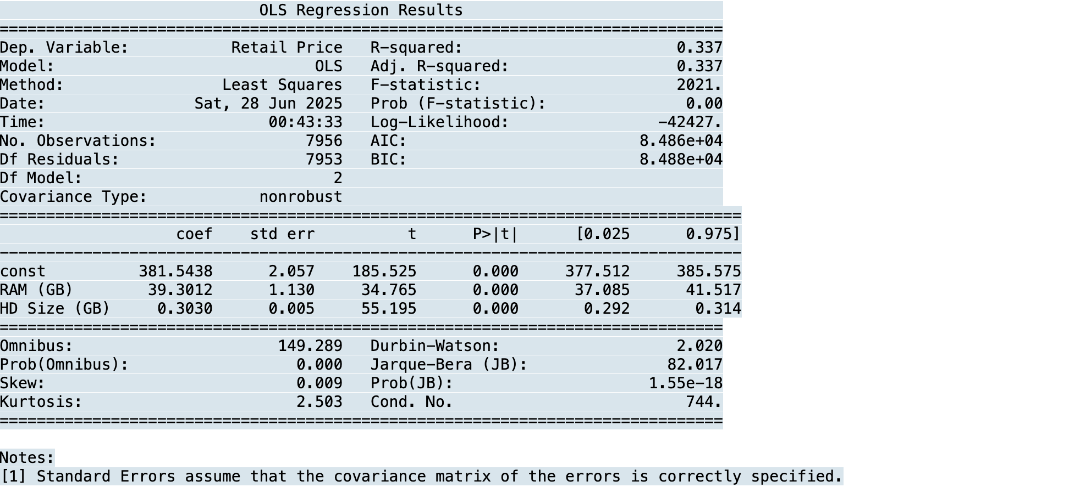
P Values of significance

Slide 20
Important statistical values
p-values
t-values
f-values

Slide 21
Statistical values
The summary statistics offer various insights.
Among these insights is the model p-Value (located at the bottom of the last line) as well as the p-Values for individual predictor variables (found in the rightmost column under ‘Coefficients’).
p-Values are crucial because a linear model can only be regarded as statistically significant when both p-Values fall below the predetermined significance level, which is usually set at 0.05.
This is visually depicted by the significance stars at the end of each row. The more stars present next to a variable's p-Value, the more significant that variable is considered.

Slide 22
t-values
A larger t-value suggests that the likelihood of the coefficient being zero due to random chance is lower. Therefore, a higher t-value is preferable.
Pr(>|t|), also known as the p-value, represents the probability of obtaining a t-value as large or larger than the one observed, assuming the Null Hypothesis is true.
This Null Hypothesis posits that the β coefficient is zero, indicating no relationship.
Consequently, if Pr(>|t|) is low, the coefficients are deemed significant (meaning they are notably different from zero).
Conversely, a high Pr(>|t|) indicates that the coefficients lack significance.

Slide 23
Use to PREDICT
Use the values of Beta and Alpha with error to predict the actual values only if p is significant.

Slide 24
Interpretation
What implications does this have for us?
When the p-value is less than the significance threshold (<0.05), we have enough evidence to reject the null hypothesis, which states that the coefficient β of the predictor is zero.
In this case, both p-values are considerably below the 0.05 threshold, enabling us to determine that our model holds statistical significance.

Slide 25
Next week
f-statistic
R-squared
More complex models applied to the same dataset.
Attempt predictions using both the training set and the prediction set derived from the same data.

